Slide 1
Billing
By: Derrick Murphy

Slide 2
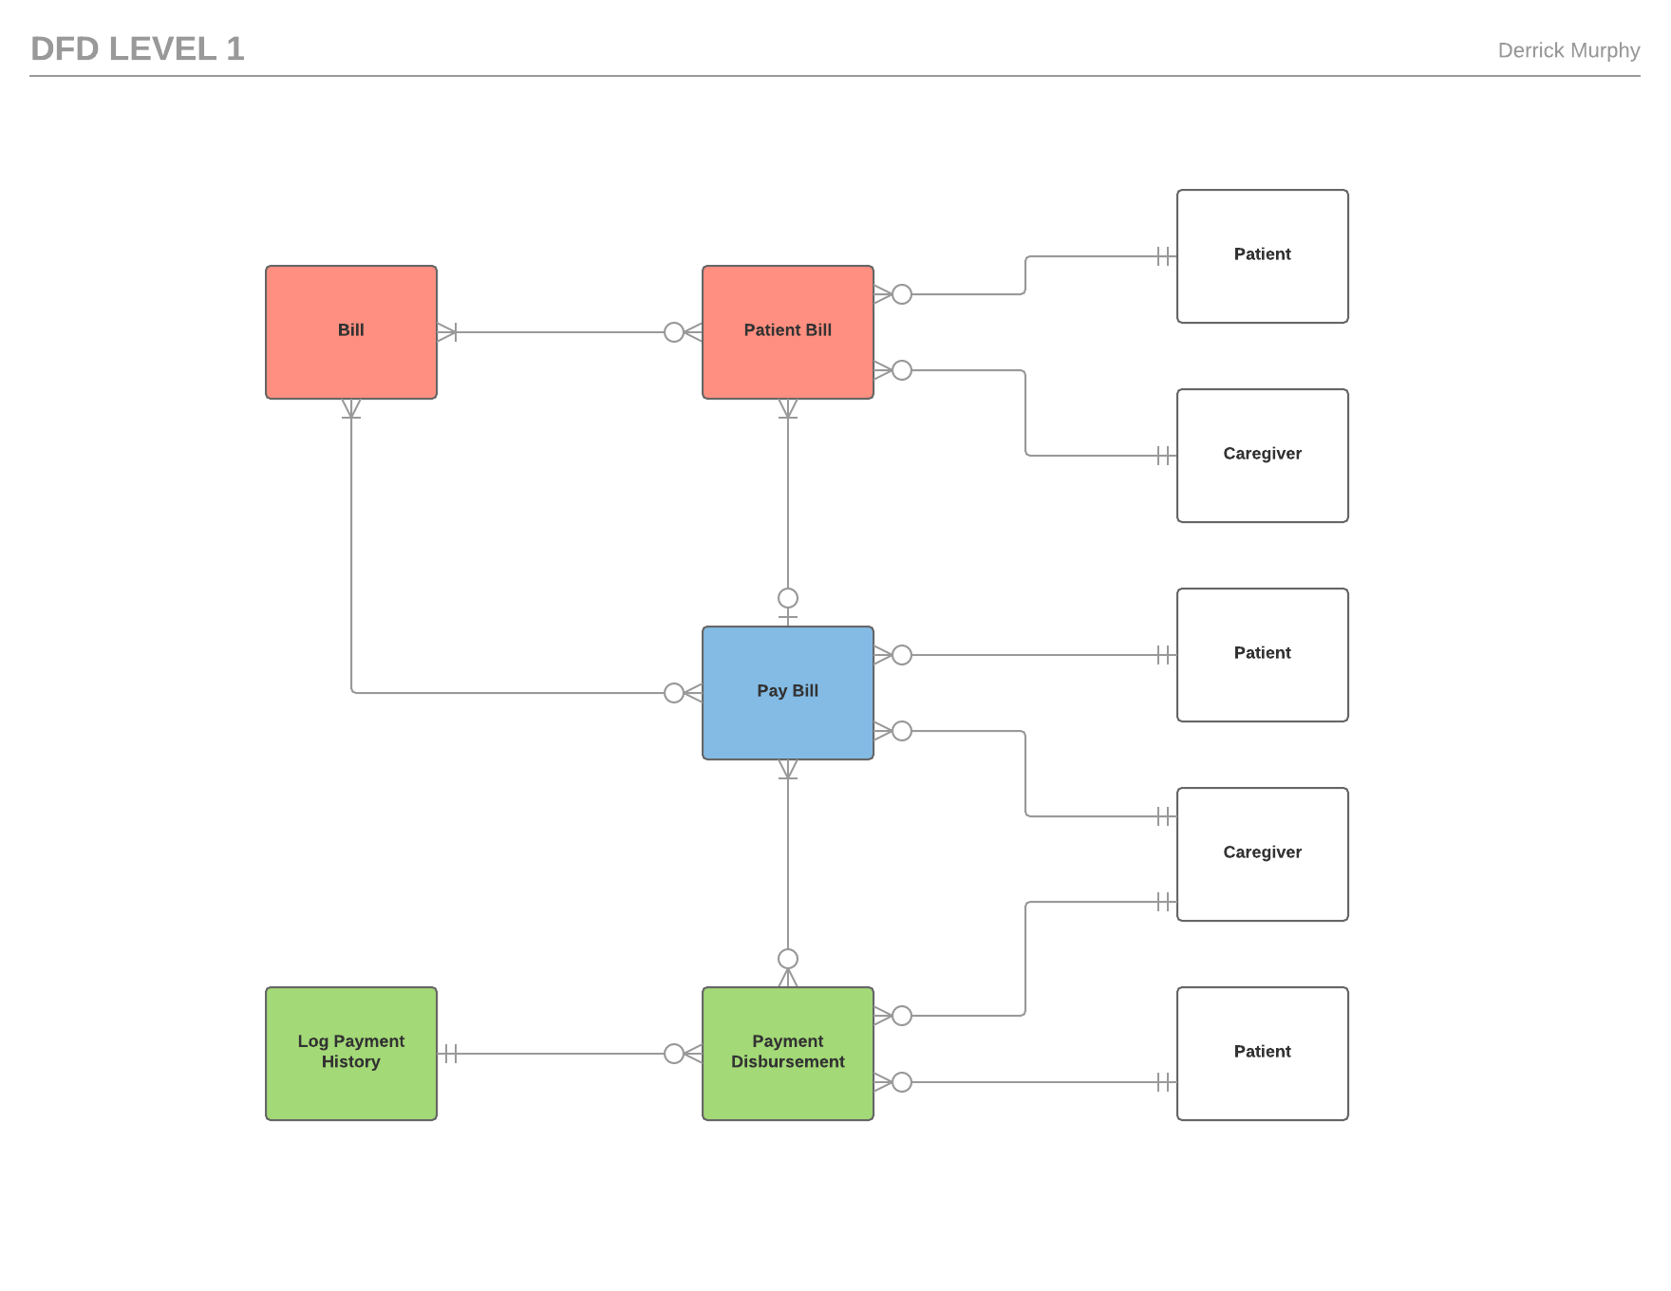

Slide 3
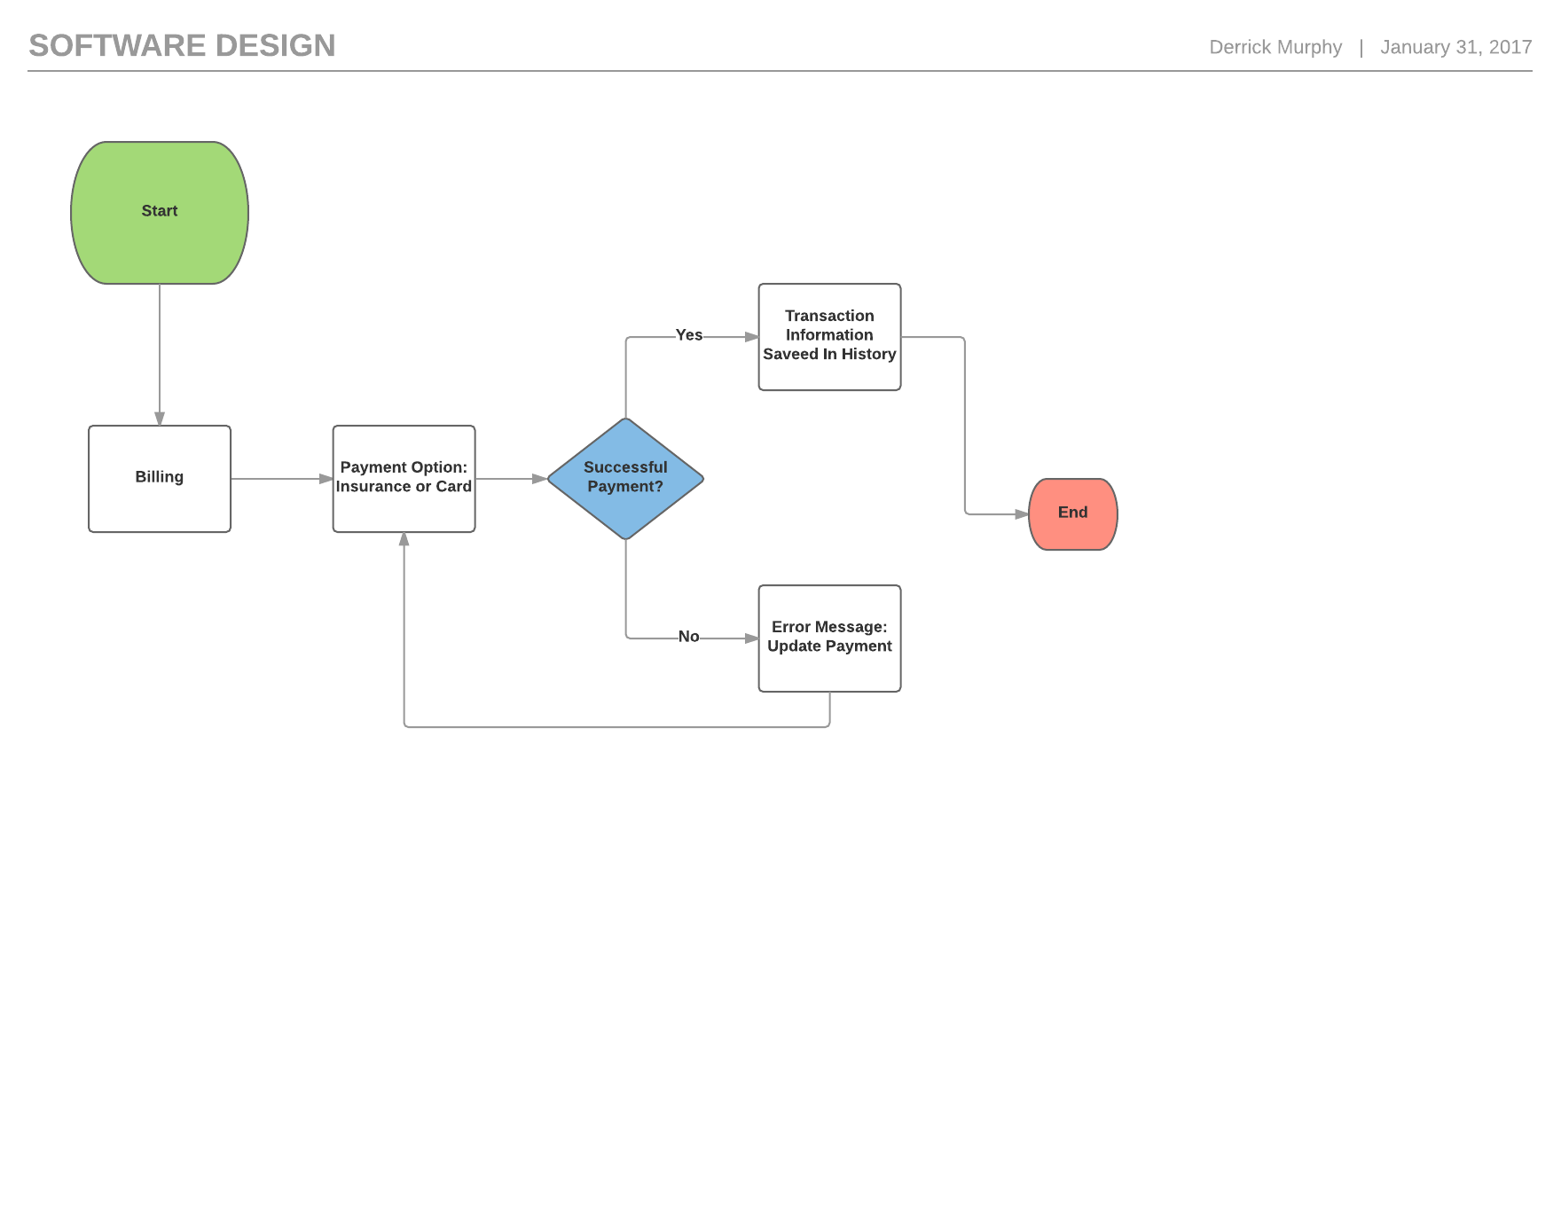

Slide 4
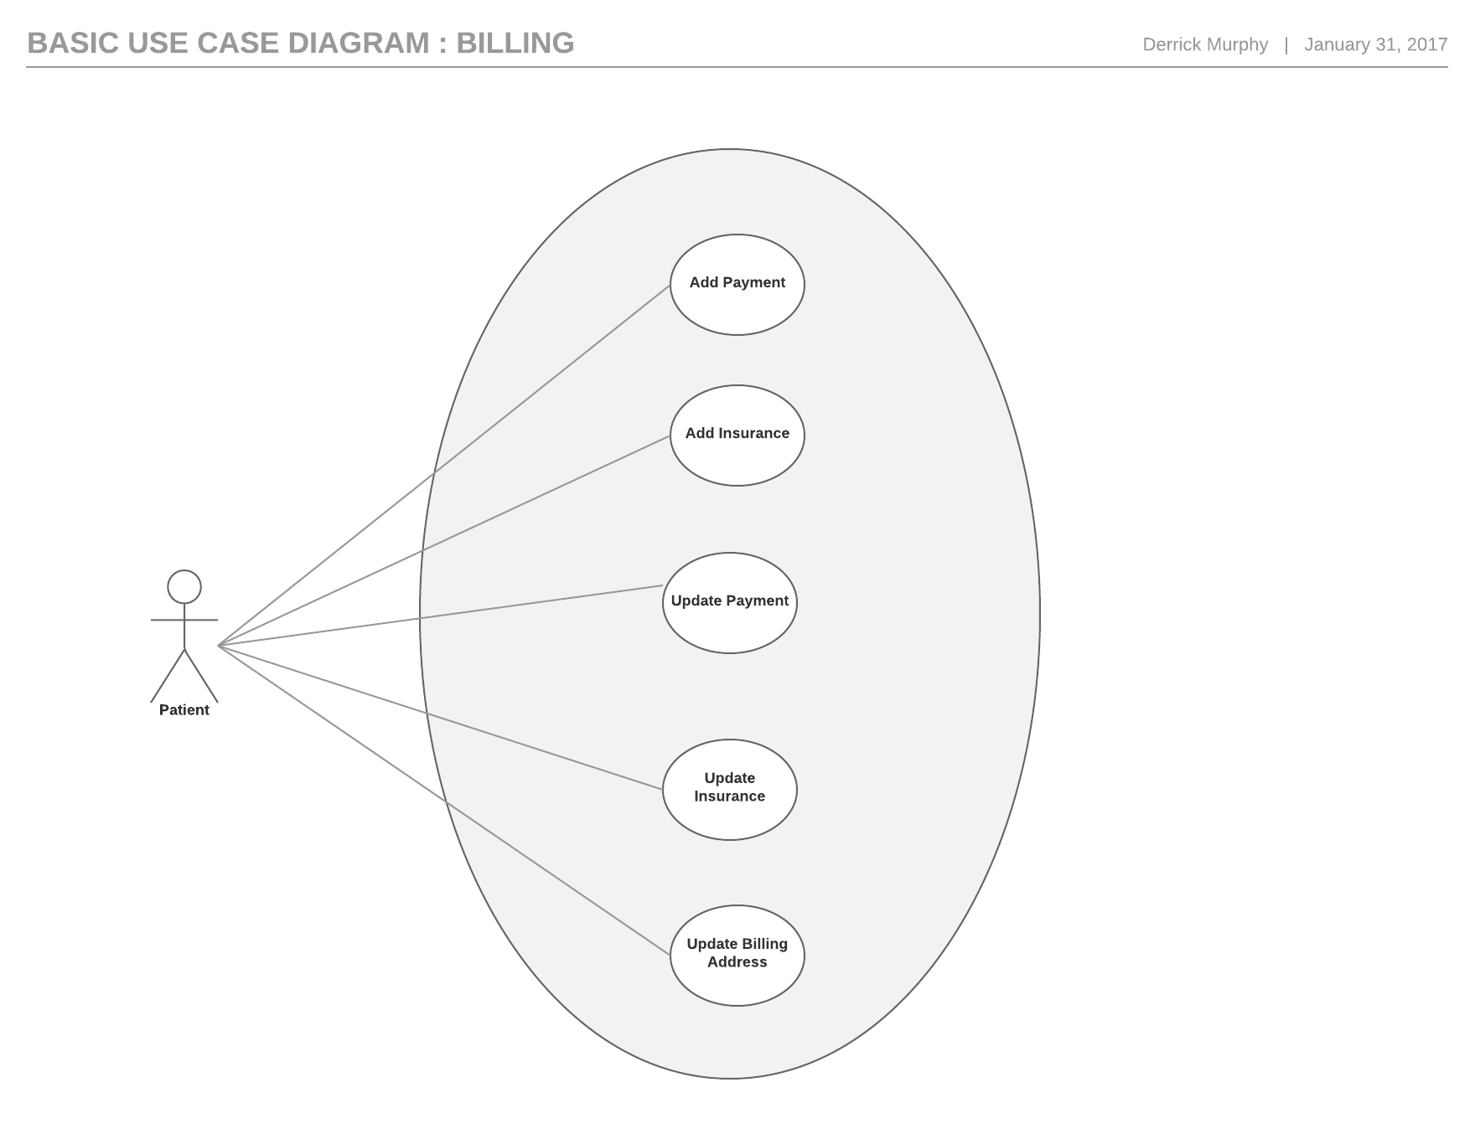

Slide 5
